Slide 1
U-DATA
Solving 80/20 data science dilemma
Notes:
Need page numbers

Slide 2





The Problem
Most data scientists spend only 20 percent of their time on actual data analysis and 80 percent of their time finding, cleaning, and reorganizing huge amounts of data, which is an inefficient data strategy…
https://www.infoworld.com/article/3228245/the-80-20-data-science-dilemma.html
https://www.glassdoor.com/List/Best-Jobs-in-America-LST_KQ0,20.htm
Data Scientist is the best job in America for the 4th year in a row in US…
Data scientists, spend from 50 percent to 80 percent of their time mired in this more mundane labor of collecting and preparing unruly digital data, before it can be explored for useful nuggets…
https://www.nytimes.com/2014/08/18/technology/for-big-data-scientists-hurdle-to-insights-is-janitor-work.html
Cleaning Big Data: Most Time-Consuming, Least Enjoyable Data Science Task,..
https://www.forbes.com/sites/gilpress/2016/03/23/data-preparation-most-time-consuming-least-enjoyable-data-science-task-survey-says/#6544fbe46f63

Slide 3
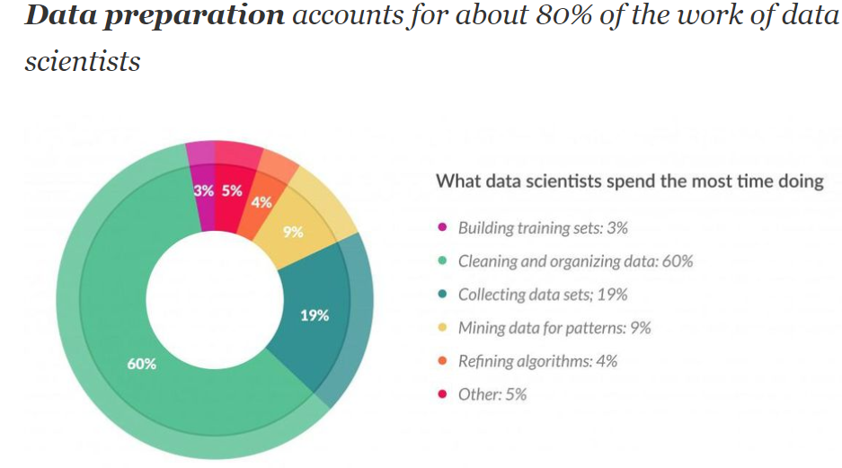
UDATA: Value Proposition
Reducing “Release to Market” time and efforts by 70% as data Scientists can concentrate only on Feature Extraction and Model Creation
Faster and more efficient way for Supervised model training.
Lets understand it better with the below use case:
Problem Statement: Ford wants to know when a particular machine is going to fail.
It has all the necessary instrumentation(Temp/Voltage/X/Y/Z) in place which is continuously monitoring the health and also writing the health information.
All of the sensors will be writing in there own format with different column headers representing different data
Usually there are several formatting inconsistencies, floating issues and inconsistent time series data.
A data scientist has to sychronize all this data and make sure that the resulting combination makes sense for further analysis.
This synchronizing and cleaning up of the data takes up up ~70 to 80% of his time.
We are in the persuit to return this quality time back to the Data Scientists.

Slide 4
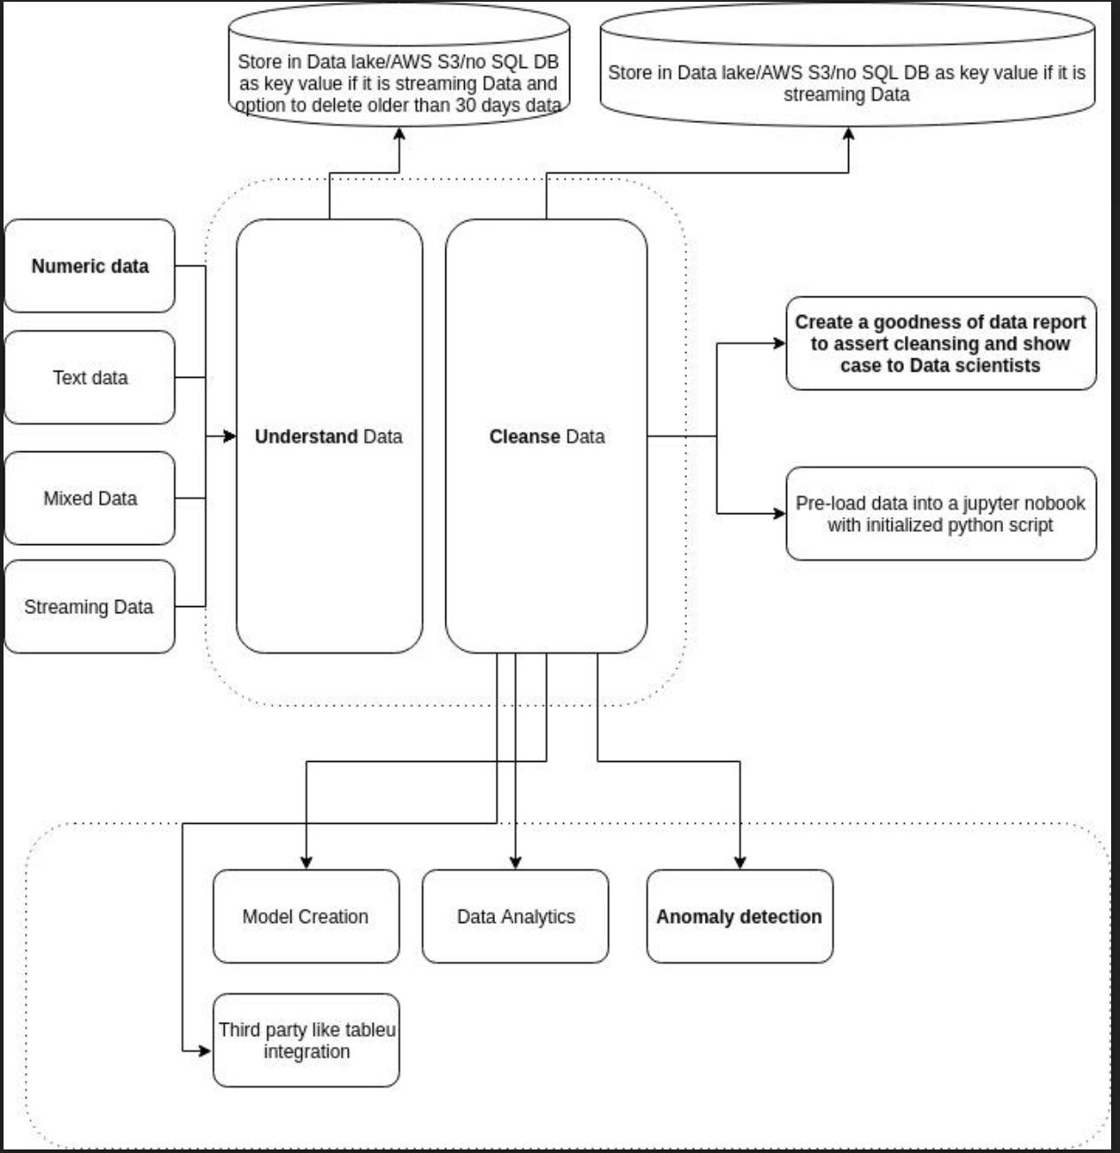
Our Approach
Components which are Market Ready:
Understanding numeric data.
Cleanse: Numeric data
Create a goodness of data report for numeric data.
Anomaly detection using basic automl.

Slide 5
Our First Target Segment - Manufacturing Sector---WHY?
Our Solution has anomaly detection which this need of the hour for this segment.
Manufacturing plants generate a lot of data from sensors which we can use and in the process help them reduce cost and increase revenues
This will be the first step in the evolution of a manufacturing plant to be SMART manufacturing plant
It is advantageous for us as well as we can collaborate with UST’s internal Manufacturing verticals and create POC/MVC and then fine tune the solution
We want to address this sector as this is considered to be not so Tech Savvy.

Slide 6
Cost and Revenue Structure
Engineering Resources
Infrastructure cost
POC Cost (Include travel and accommodation costs of Engineers at client site)

Slide 7
Demo

Slide 9
THANK YOU

